Slide 1


Web Development Front-End and Project
This presentation details the front-end development of my travel website. It covers key technologies and project templates.
AK
by Akrita Kaur

Slide 2

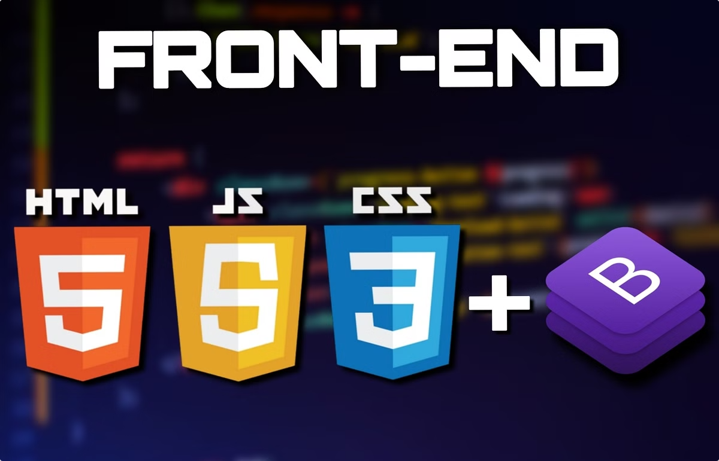
Introduction to Front-End Web Development
1
HTML Structure
2
CSS Styling
Provides the basic structure and content of a webpage.
Adds visual appeal and presentation to the content.
3
JavaScript Interaction
Enables dynamic behavior and user interaction.

Slide 3
Why We Choose the MERN Stack
MongoDB
Express.js
React & Node.js
NoSQL database for flexible data modeling.
A Node.js framework for building APIs.
JavaScript frameworks for efficient development.

Slide 4
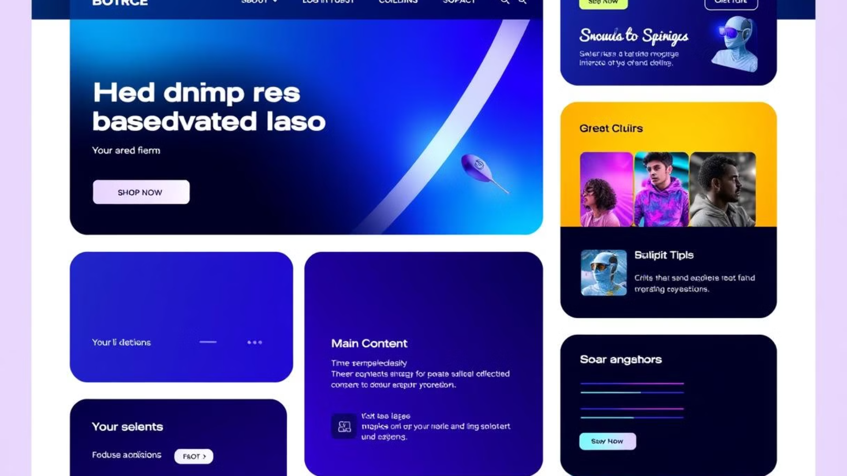
HTML Syntax and Layout Tags
Basic Tags
Semantic Tags
Layout Tags
Learn fundamental tags like <p>, <h1> - <h6>, <a> etc.
Use semantic tags like <header>, <nav>, <article>.
Utilize <div>, <span>, <section> for structure.

Slide 5
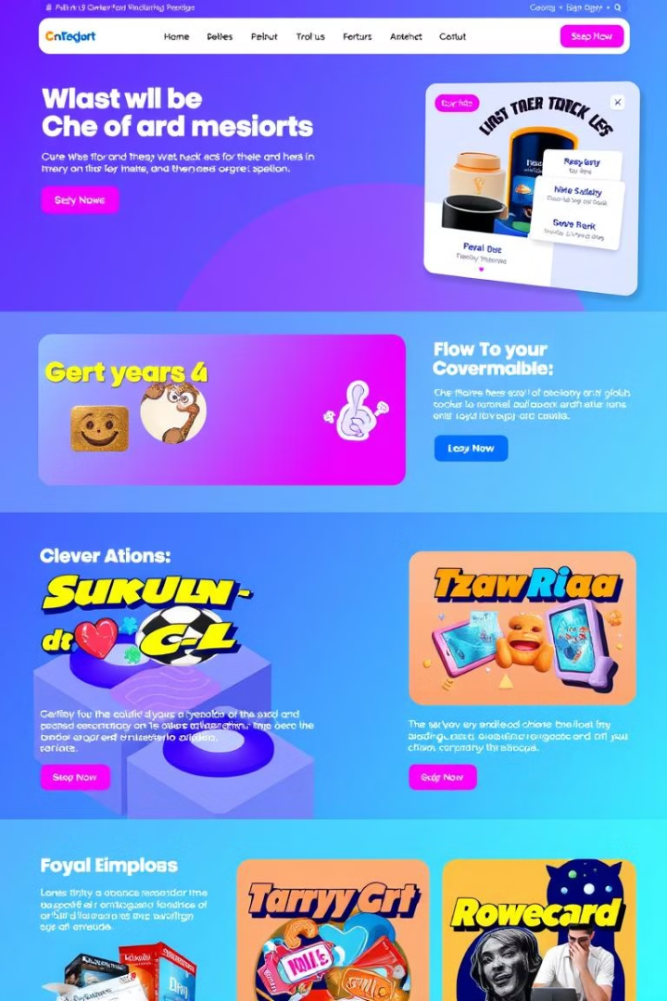



Cascading Style Sheets (CSS)
Selectors
Target specific HTML elements for styling.
Properties
Define the visual characteristics.
Values
Assign specific settings to properties.

Slide 6
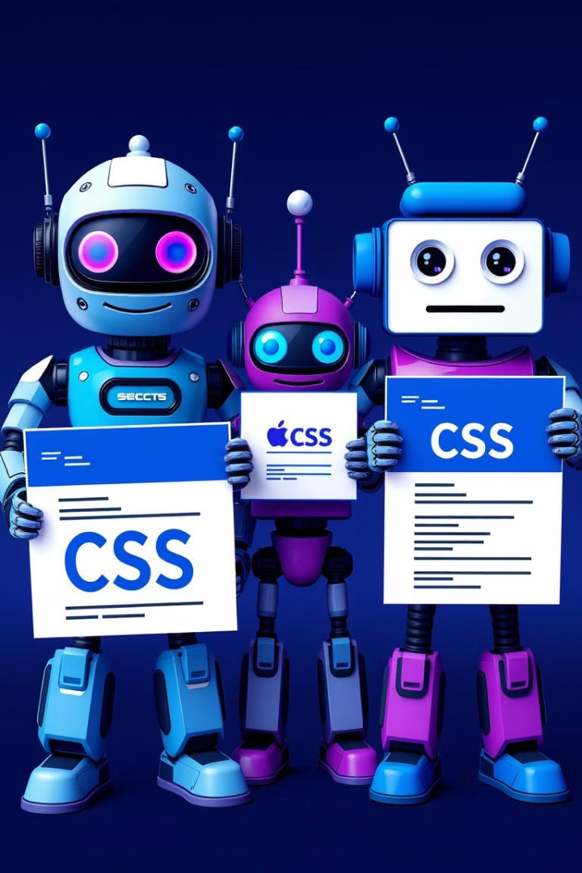
CSS Types, Syntax, and Usage
Type
Description
Example
Inline
Within HTML tag
<p style="color:blue;">
Internal
Within <style> tag
<style> p {color:red;} </style>
External
Separate CSS file
<link rel="stylesheet" href="style.css">

Slide 7
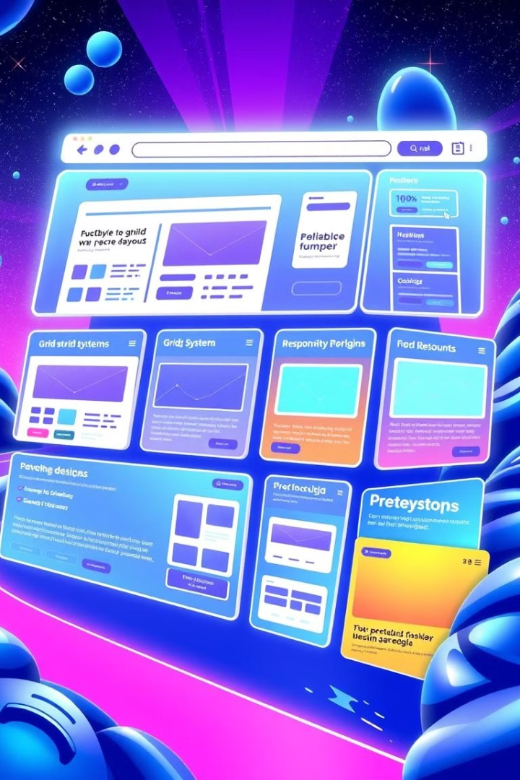
Bootstrap and Layout Design
1
Grid System
Flexible and responsive layout.
2
Components
Pre-built UI elements for quick design.
3
Responsiveness
Adapts to various screen sizes.

Slide 8
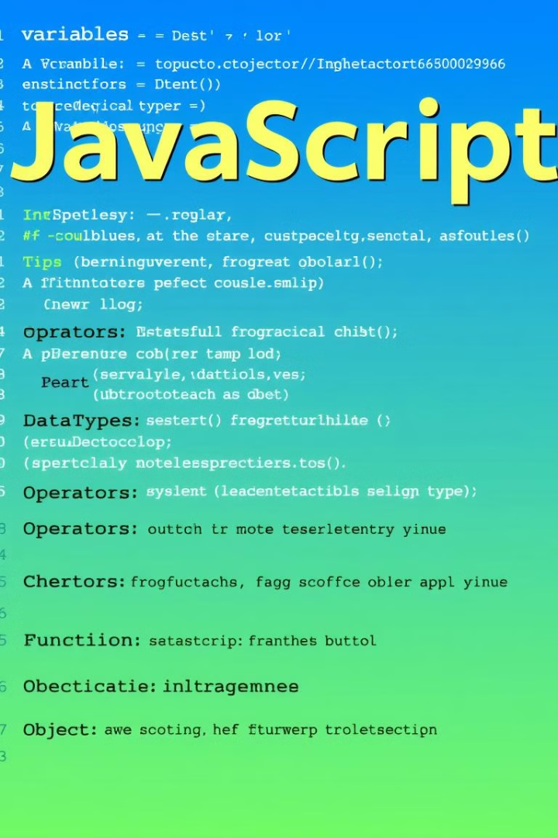

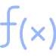


Overview of JavaScript
Variables
Functions
Store data values.
Reusable code blocks.
Events
DOM Manipulation
Handle user interactions.
Modify webpage content.

Slide 9

Project Work :
Tour And Travel Website

Slide 10
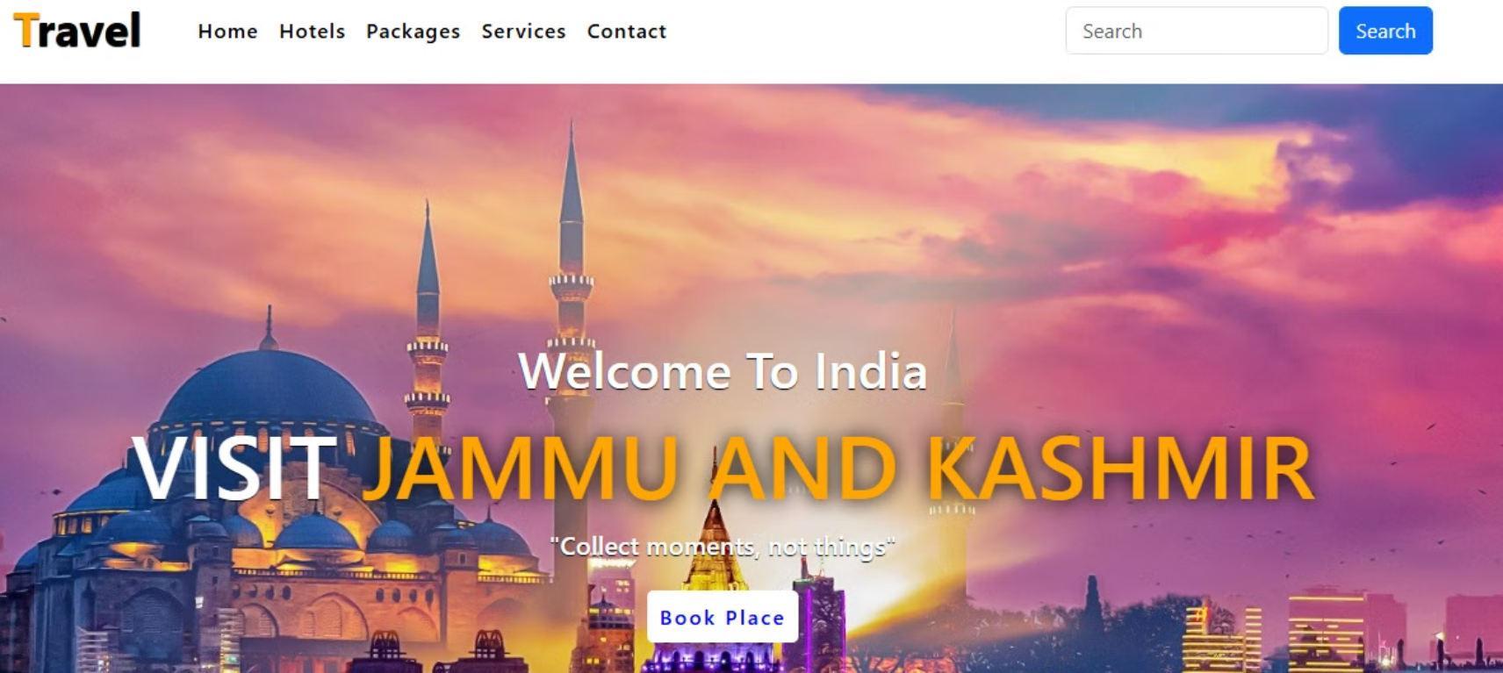
NAVBAR
BANNER AREA
Home Page

Slide 11

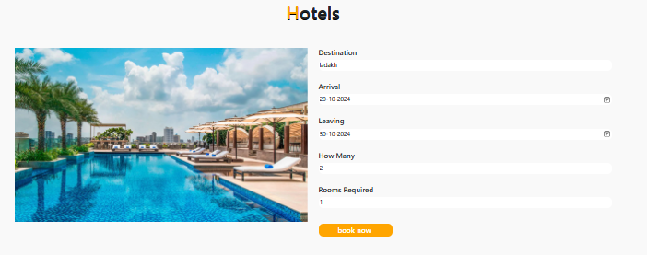
Booking page

Slide 12
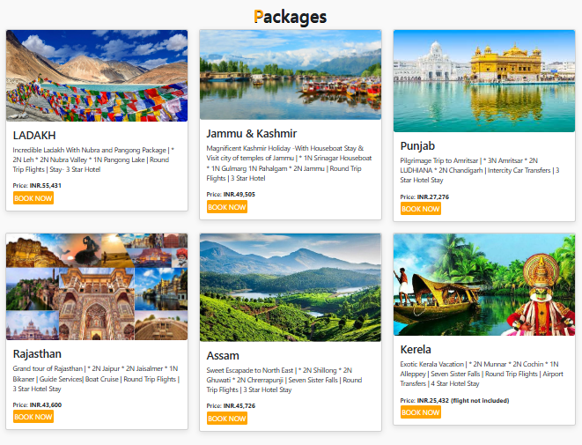
CARDS
Visit Destinations

Slide 13
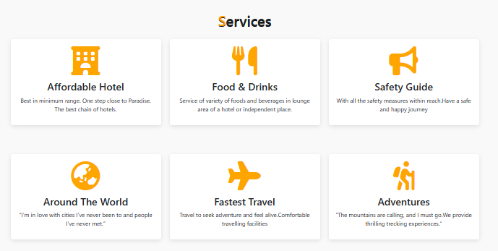
Services That Will Be Provided

Slide 14
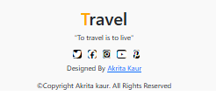
Contact Handles / Footer

Slide 15

PPT BY- AKRITA KAUR
CRN-2215007
URN-2203394
CLASS- D3 CSEA1

